Slide 1
WinEDGE BI Project
Mohamed Achek
Mohamed Amine Saoudi

Slide 2
Table of contents
1
4
Introduction
Snowflake schema
2
5
Data Gathering
ROLAP
3
6
ETL process
Dashboards

Slide 3
Introduction
OLTP
Need for analytics tools
OLAP
They are not optimized for complex analytics or large-scale data insights.
OLTP systems are insufficient for meaningful insights.
They are designed for complex data analysis and multidimensional queries.

Slide 4
Data Gathering
CSV
SQL
NoSQL
Structured data
Structured data
Mongodb data (unstructured data)
Data sources

Slide 5
ETL process
Extract
Transform
Load
The sales data is cleaned, filtered, and structured.
Data is loaded into a target system. ( PostgreSQL )
Sales data is collected from various sources. ( SQL / CSV / Mongodb )

Slide 6
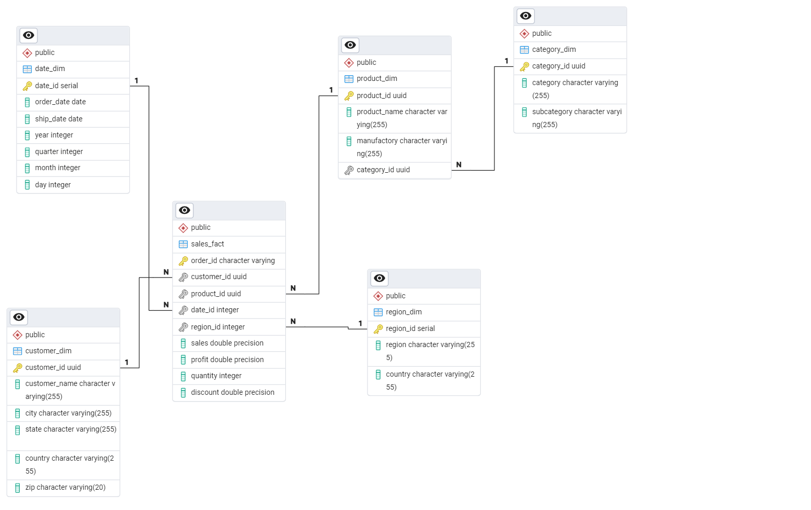
Snowflake Schema

Slide 7
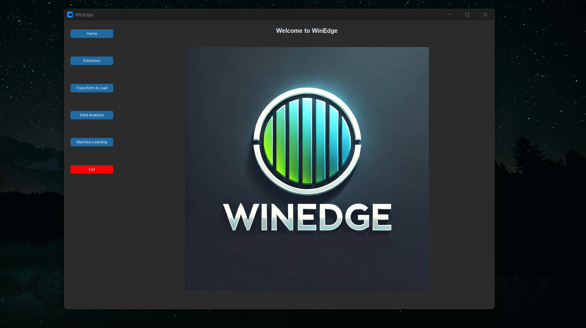

Slide 8
OLAP Types
MOLAP
ROLAP
HOLAP

Slide 9
OLAP Types
MOLAP
ROLAP
HOLAP

Slide 10
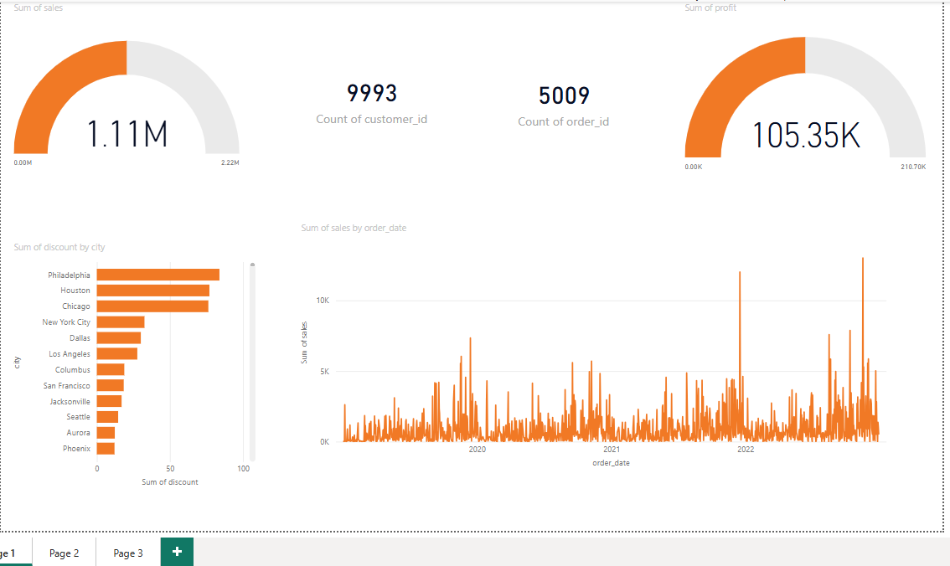
Dashboards

Slide 11
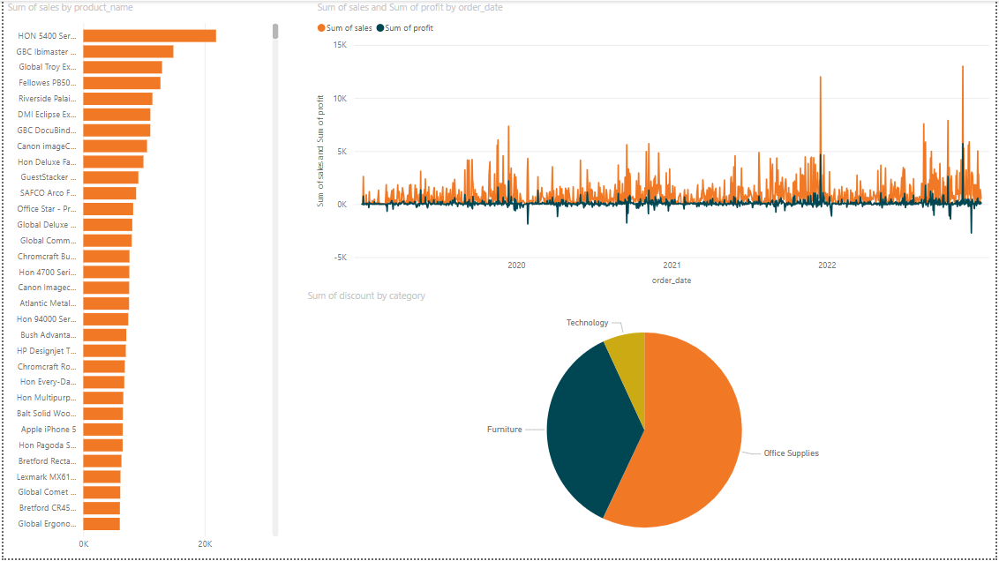
Dashboards

Slide 12
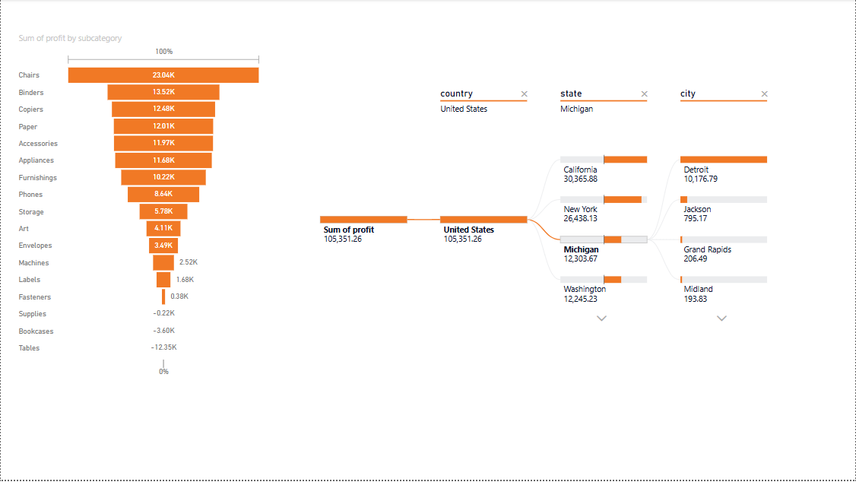
Dashboards

Slide 13
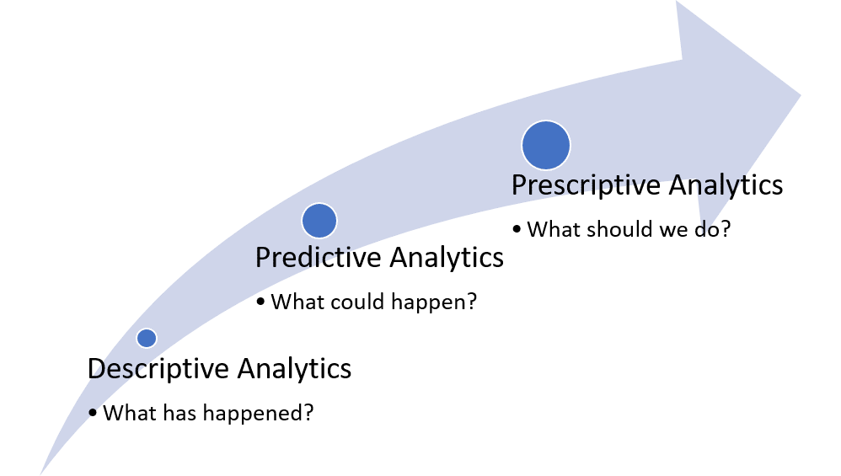

Slide 14
2593.34$
Machine Learning
Predicted total sales of 2023

Slide 15
Thank You !

